Slide 1
Wiktoria’s Secrets
UQ-Bio Summer School
June 18, 2024
Colorado State University
Wiktoria, Samantha, Pilar, Kaan, Jakini, and Eric

Slide 2
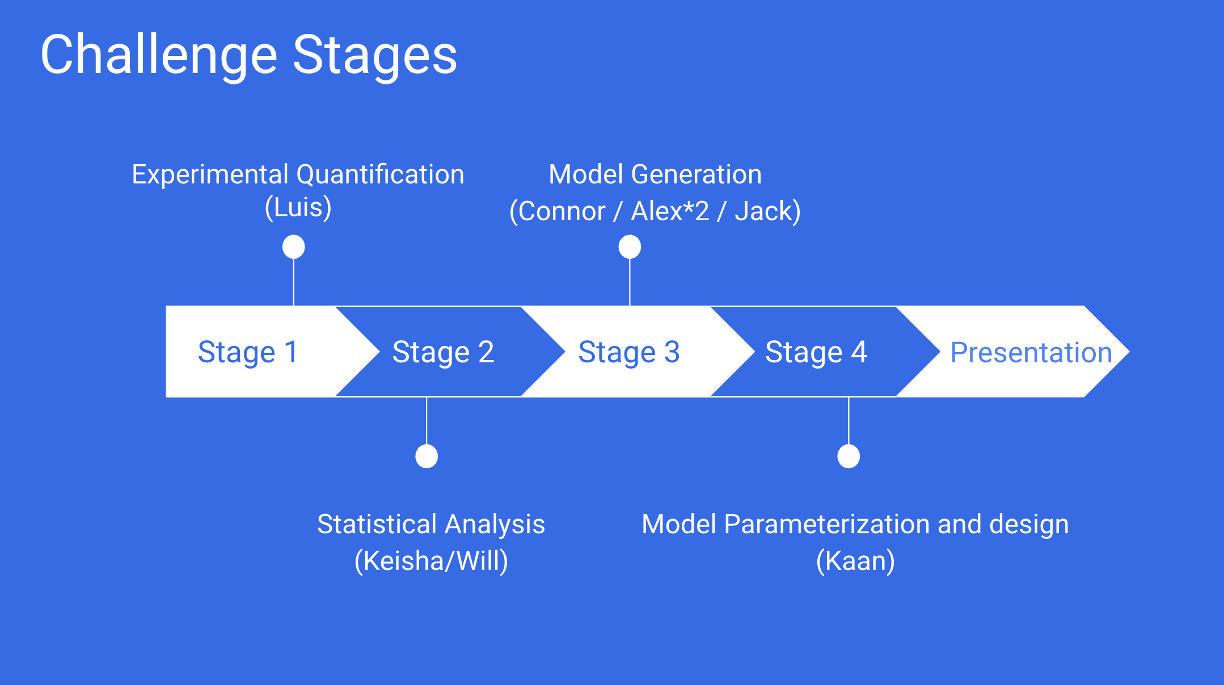

Slide 3
Stage 1: Experimental Quantification

Slide 4
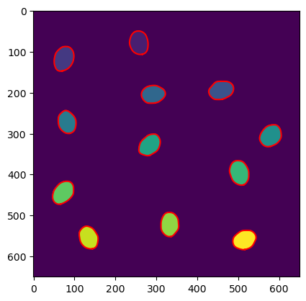
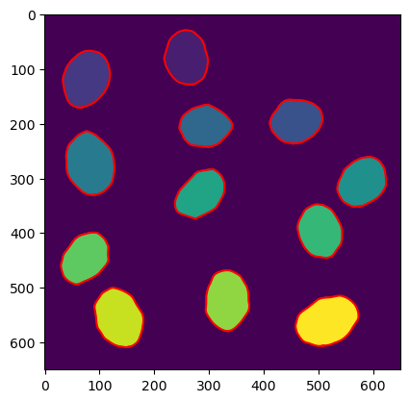
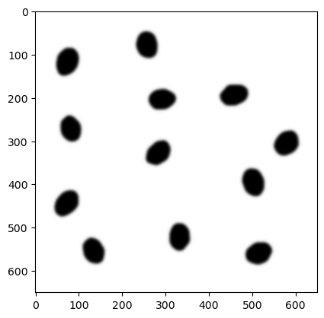
gaussian filter histogram visualization treshold choose watersheld different values for each cel – thats how we can differentiate tchem regionprops function – to calculate amount of cells/nuclei, masks to calculate cell/nuclei size (sum of pixels with given value), intensity – mask + oryginal channel green → mean value of pixels in given cell
Steps to get the csv file with the data for each drug:

Slide 5
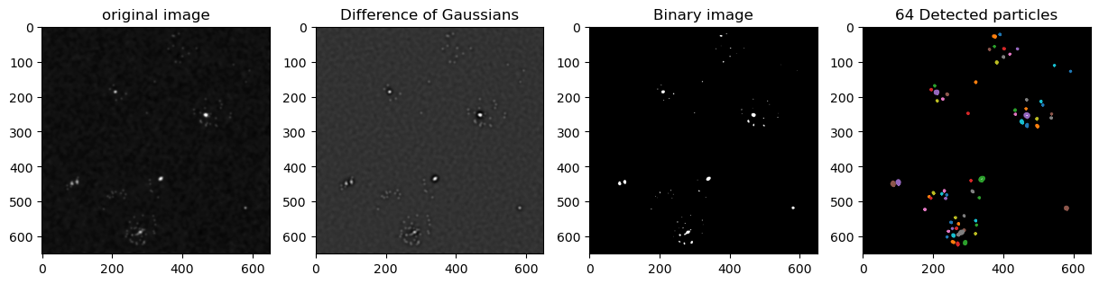
Steps to get the csv file with the data for each drug:

Slide 6
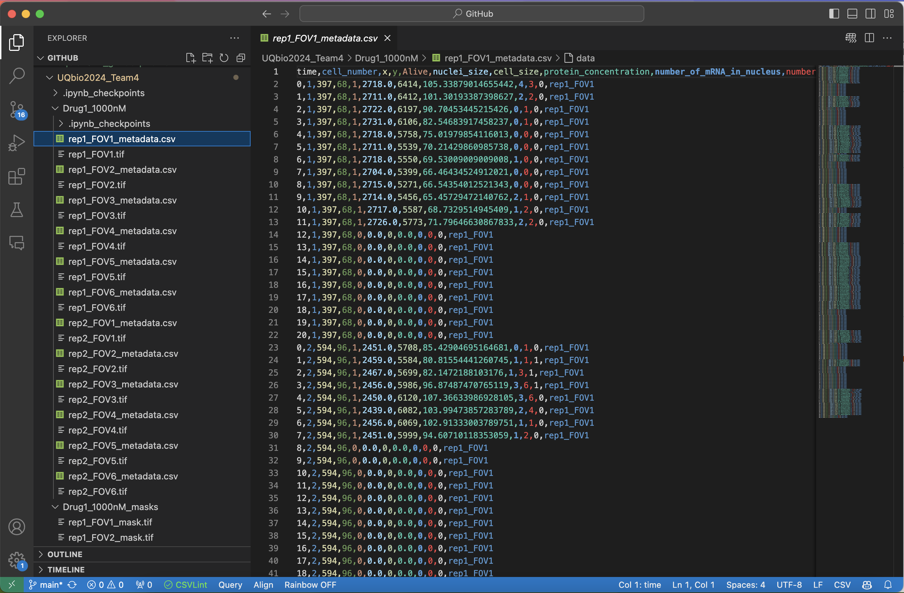

Slide 7
Stage 2: Statistic Analysis

Slide 8
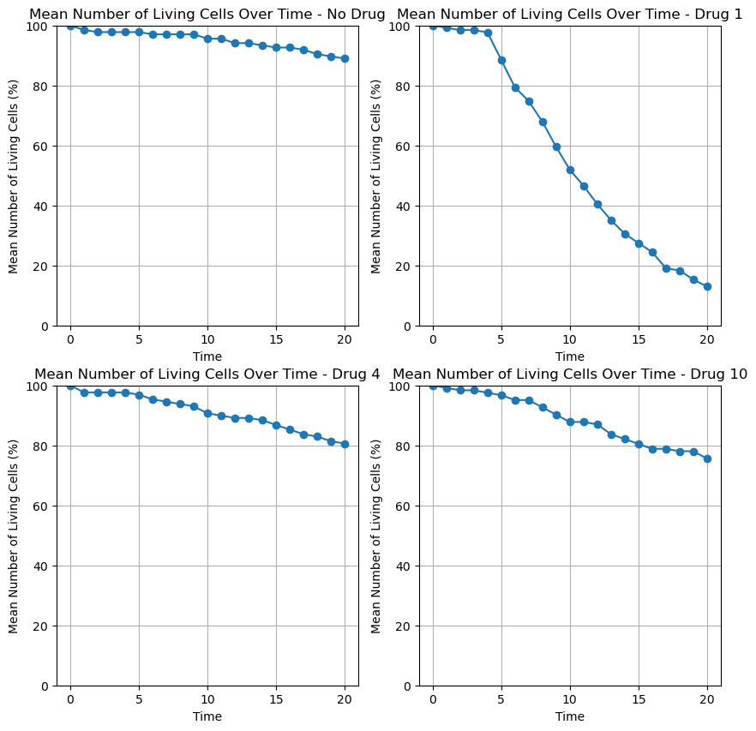
Vitality
No drug
Drug 1
Drug 4
Drug 10

Slide 9
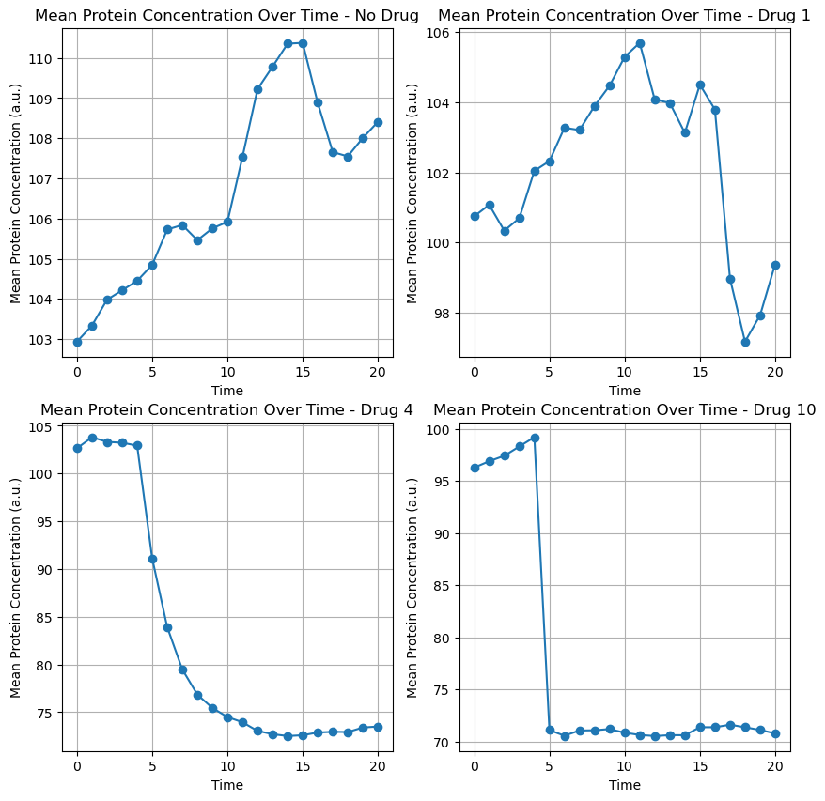
No drug
Drug 1
Protein
concentration
Drug 4
Drug 10

Slide 10
Potential Drugs
Drug
2
Drug
4
Drug
6
Drug
7
Drug
8

Slide 11
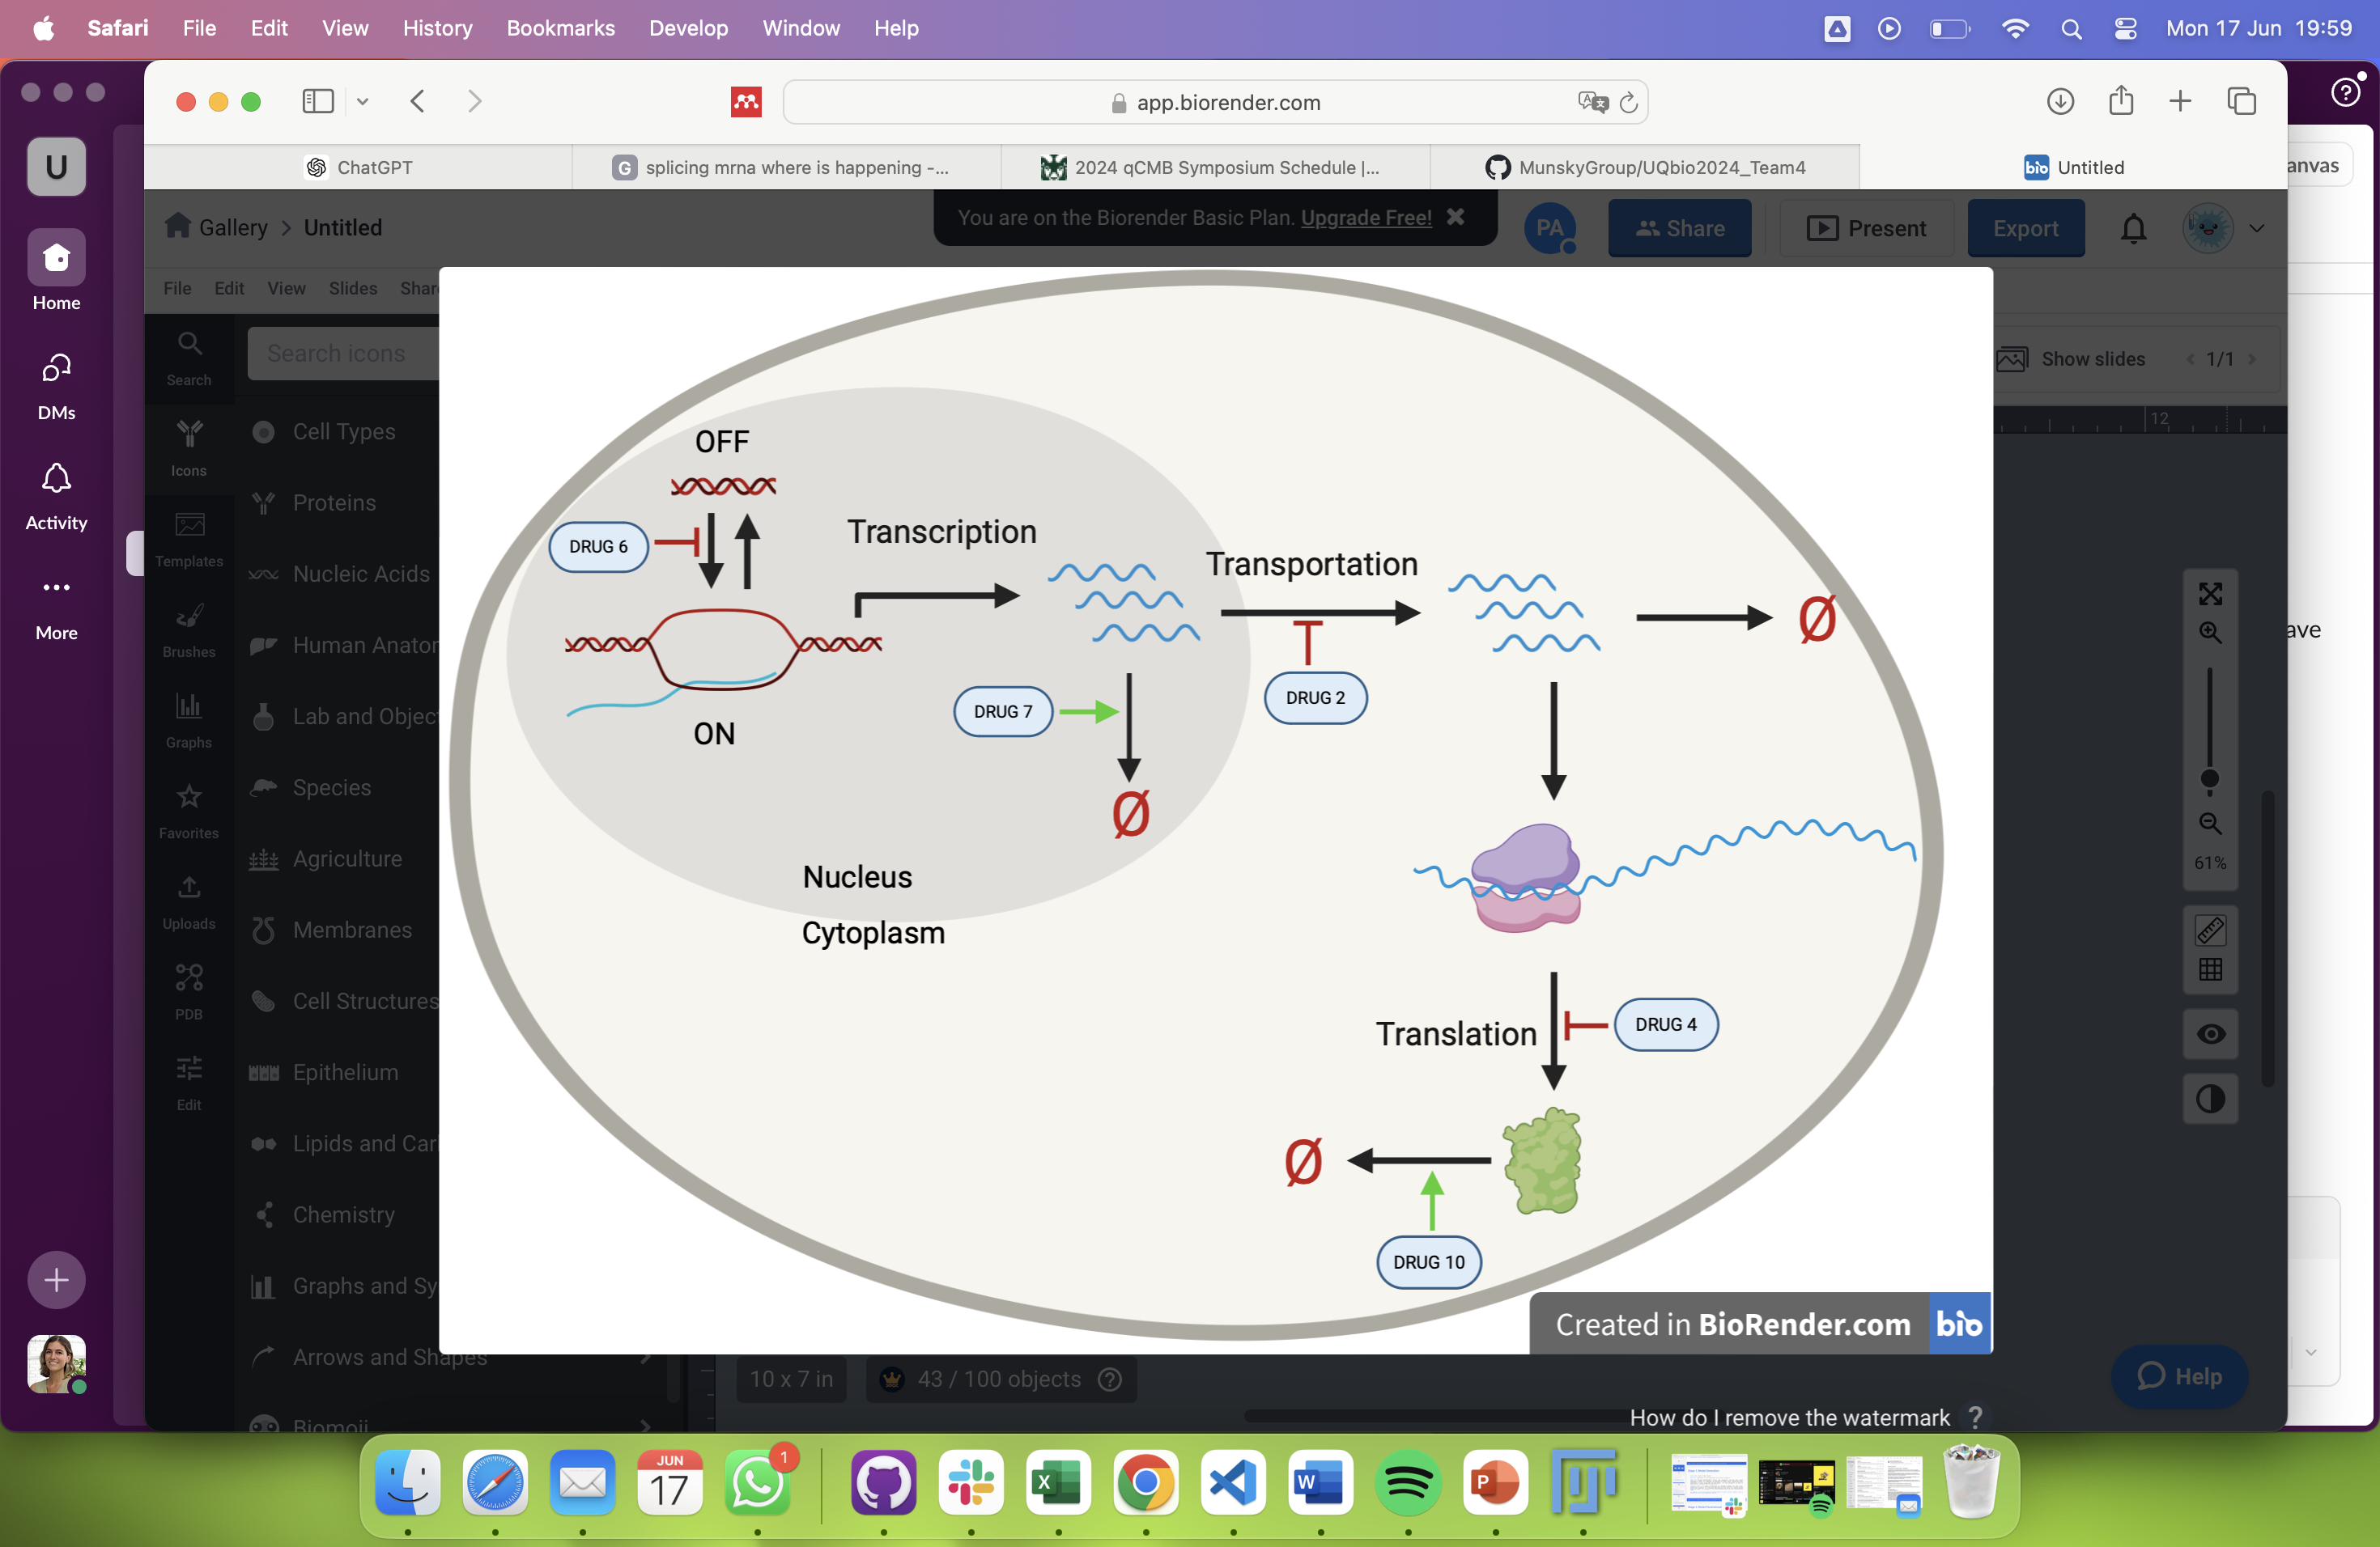
Proposed model

Slide 12
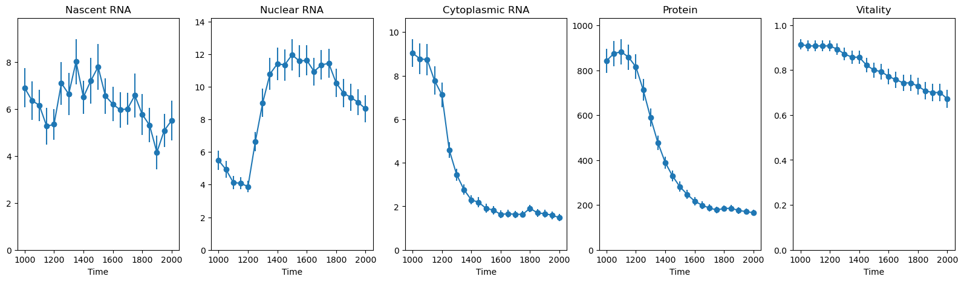
Drug 2

Slide 13
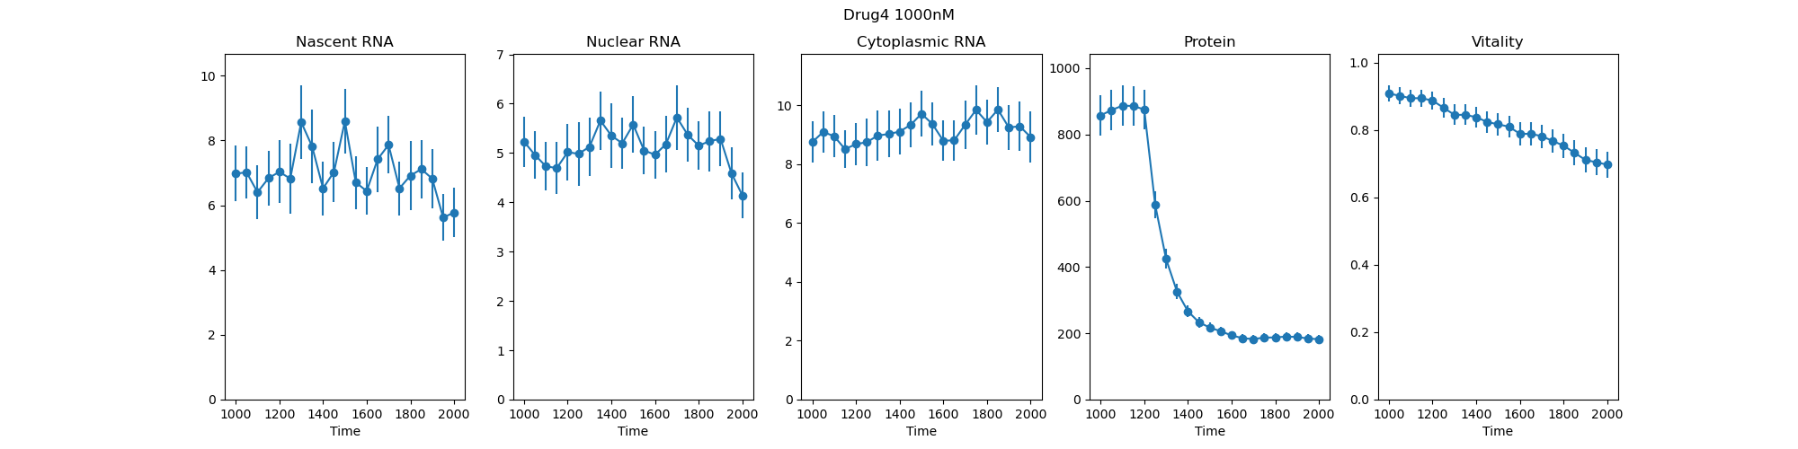
Drug 4

Slide 14
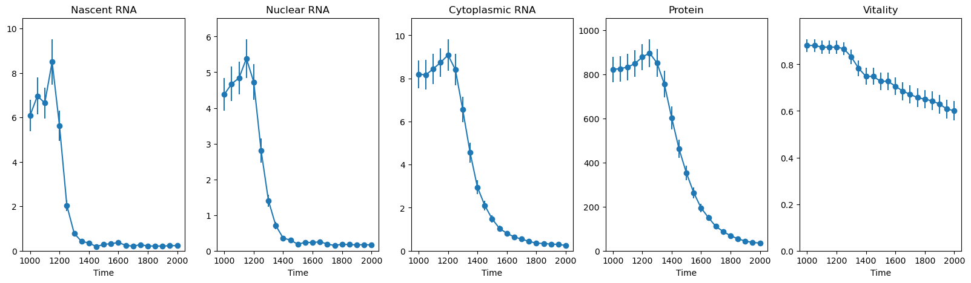
Drug 6

Slide 15
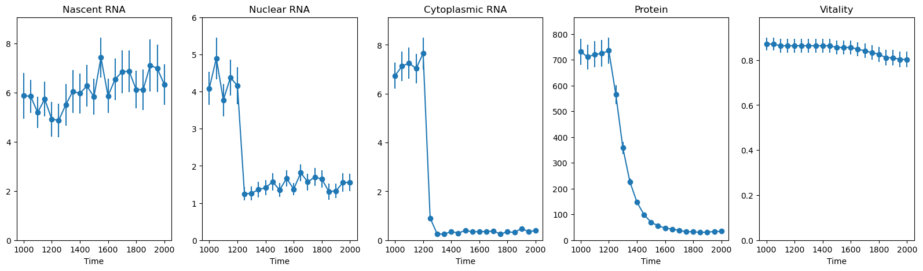
Drug 7

Slide 16
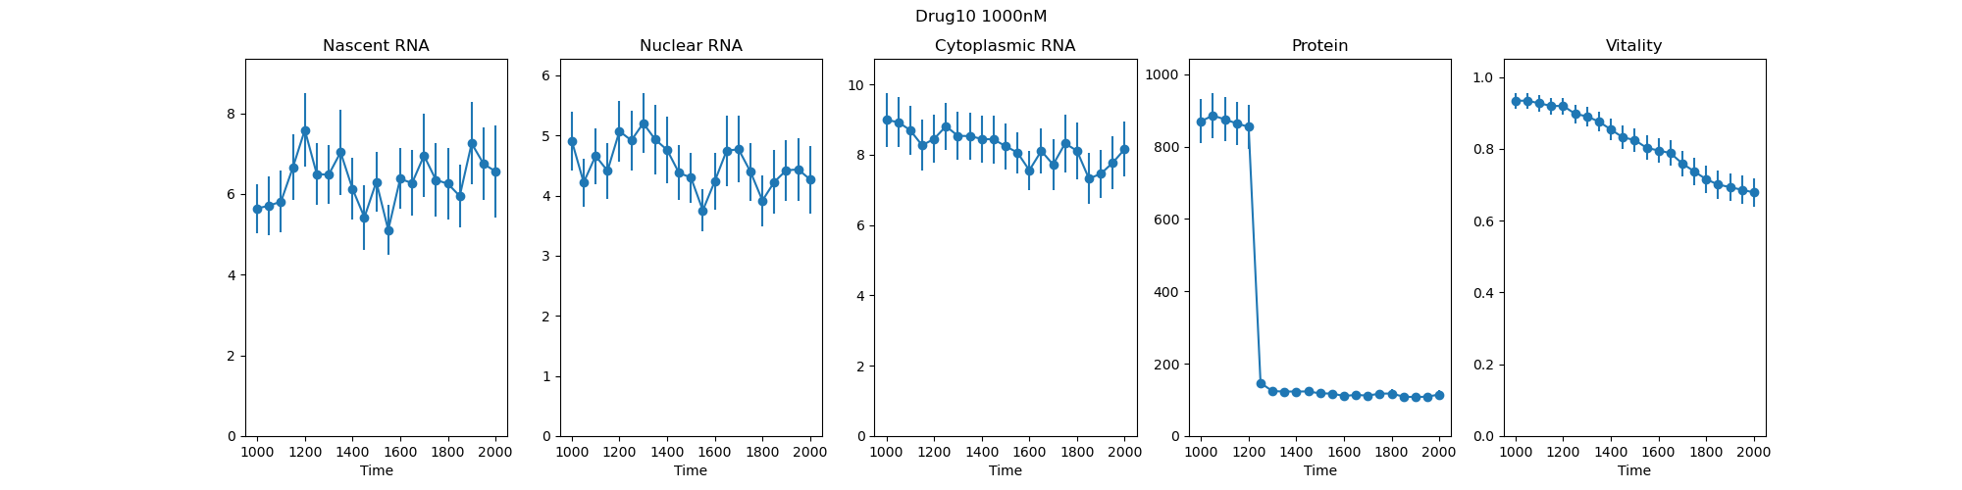
Drug 10

Slide 17
Stages 3 and 4: Model Generation, Paramerization and Desing

Slide 18
Pre-selection of Drugs concentration
DRUG | 100nM | 300nM | 1000nM | 3000nM | 10000nM
Drug2 | OK | OK | OK | ----------------- | -----------------
Drug4 | OK | OK | OK | ----------------- | -----------------
Drug6 | OK | OK | OK | ----------------- | -----------------
Drug7 | OK | OK | OK | OK (50% vit) | -----------------
Drug10 | OK | OK | OK | ----------------- | -----------------
__ PROTEIN NOT AFFECTED OK: vitality > 20%

